Slide 1
Fulton CSD 2024-2025
Board of Education
Budget Update
3/12/2024

Slide 2
Parameters
FCSD Mission
The Fulton School Community will empower students to develop the knowledge and skills to become respectful, responsible, productive citizens who are committed to lifelong learning.
FCSD Vision
Our vision is to create a learning organization that is the centerpiece of the community, where all are welcomed and held to standards of excellence that foster hope and resilience for the future.
FCSD Core Beliefs - Values
All students can learn
Expectations drive outcomes
It is our responsibility to foster a culture of growth in our school and community
Community support is essential to the success of our students
Positive, safe, and supportive environments are vital
FCSD Guiding Principles
The FCSD shall create a safe, secure, and positive learning environment through moral and ethical decision-making which fosters effective relationships among students, parents, and staff.
2. The FCSD shall communicate effectively and intentionally throughout the district and with all communities of which it is a part.
3. The FCSD shall provide quality educational experiences which meet the needs of all learners.
4. The FCSD shall be fiscally responsible through using sound and efficient practices in all matters.
3

Slide 3
FCSD Strategic Coherence Plan
4

Slide 4
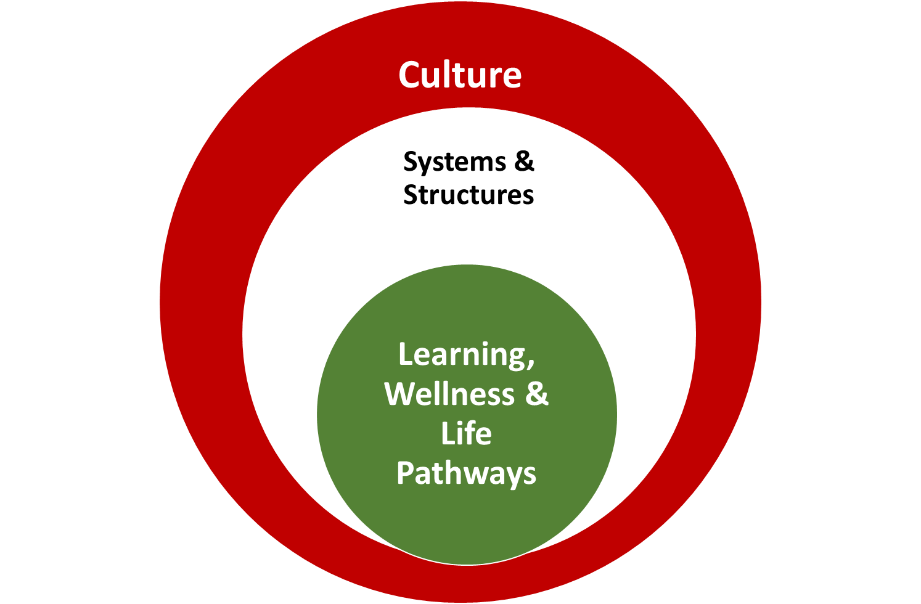
Culture:
You belong here.
It is safe to speak up here.
What we do is important.
This is who we are and how we act, interact with and respond to others.
It is what we value and believe.
Systems & Structures:
Systems for Teaching and Learning
Facilities, Operations & Finance
Human Resources
Technology
This is how we do our work.
Learning, Wellness &
Life Pathways:
High levels of relevant learning and growth for every person
Social-emotional wellness
Future orientation = life goals!
This is why we do our work.

Slide 5
SCP Outcomes for 2024-2029
School experiences are relevant, engaging and foster a sense of belonging and purpose for every student.
Every student is an engaged learner who is well-prepared for their future.
Every member of the school community feels safe and valued as essential partners.
The Fulton City School District is innovative, proactive and accountable.

Slide 6
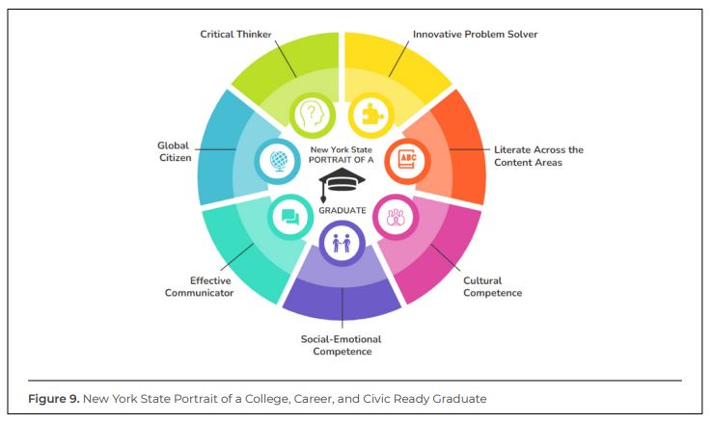
Critical Thinker
Innovative Problem Solver
Literate Across the Content Areas
Cultural Competence
Social-Emotional Competence
Effective Communicator
Global Citizen
Portrait of a Graduate
7

Slide 7
Financial Considerations and Key Budget Impacts
The cost of educating our students has increased - COVID outcomes, Learning loss, SEL factors.
National Figures: 13% of 8th Graders in the United States met U.S. History proficiency standards.
33% of 4th Graders were proficient in Reading and Math
2023 saw the largest increase in per pupil cost in over a decade (up 6.3% Nationally).
New York is the highest at $26,571 (FY 2021). Fulton Per Pupil: $22,828.00 County Avg. $22,561.07 State: $25,870.33
Safety and Security - $700K 2023-24
Unanticipated costs - , Significant increase in healthcare costs, Maint. & repairs, Absences and attendance, etc.
Inflation - Compounded impact over several years
NYSED Data link - Fulton City School District 2021-2022
8

Slide 8
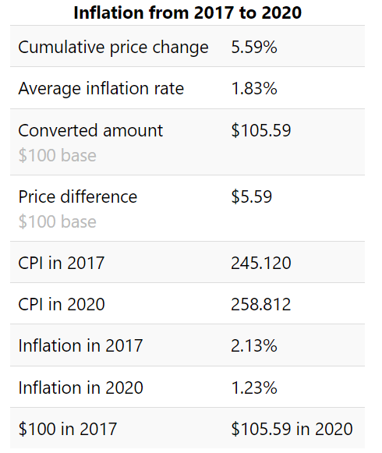
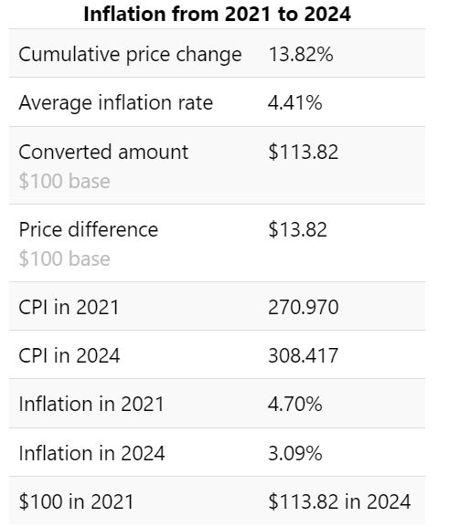
Financial Considerations and Key Budget Impacts
8

Slide 9
Projected Revenues
Summary Projection
 | 2024-2025
Tax Levy | $22,045,571
State Aid Foundation Aid Transportation Aid w/o summer Building Aid BOCES Aid High Cost Aid Hardware and Tech Aid Software,Library and Textbook | $62,948,724 $45,463,973 $4,471,888 $3,691,920 $7,408,970 $1,599,192 $63,968 $248,813
Misc Other | $1,341,900
Total: | $86,336,195
*Foundation Aid Increase from 23-24 = 4.0% - $1,754,367
* Does not include Pre-K: $952,177
*Total Aid increase from 23-24: 7%

Slide 10
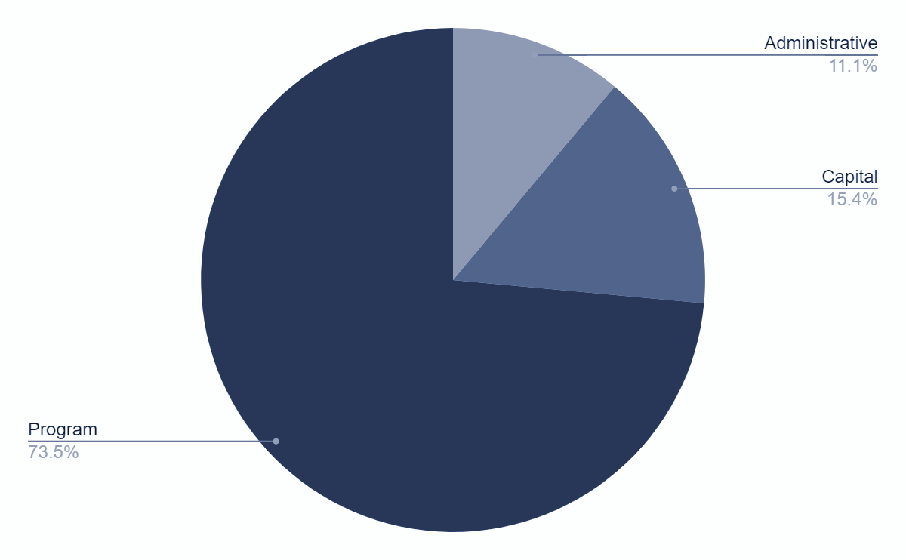
Preliminary Budget
Budget Component | $ Amount
Administrative | $9,700,295
Capital | $13,682,231
Program | $66,224,935
Total | $89,607,461

Slide 11
Property Tax Comparison 3.92% Tax Cap
 | 0% | 0.5 % | 1% | 1.50% | 2% | 2.50% | 3% | 3.50% | 3.92%
Amount based on % increase | $22,045,571 | $22,155,799 | $22,266,027 | $22,376,255 | $22,486,482 | $22,596,710 | $22,706,938 | $22,817,166 | $22,918,576
Change from 23-24 | - | $110,228 | $220,456 | $330,684 | $440,911 | $551,139 | $661,367 | $771,595 | $864,186

Slide 12
Estimated Impact of 2% Increase
Home with assessed values:
*After basic STAR exemption
$100,000.00
$200,000.00
$300,000.00
$32.20 - Per Year increase
$78.20 - Per Year increase
$124.20 -per year increase

Slide 13
Estimated Impact of 3.5% Increase
Home with assessed values:
*After basic STAR exemption
$100,000.00
$200,000.00
$300,000.00
$56.35 - Per Year increase
$136.85 - Per Year increase
$217.35 -per year increase

Slide 14
Year | Budget | Enacted Levy | $ Increase over prior | Percent Increase | Permissible Levy Cap | Permissible $ Increase | Permissible % Increase
2014-15 | $67,357,685 | $20,142,125 | $199,427 | 1.00% | $20,581,198 | $638,500 | 3.20%
2015-16 | $68,641,061 | $20,494,612 | $352,487 | 1.75% | $20,952,427 | $810,302 | 4.02
2016-17 | $70,336,500 | $20,583,063 | $88,451 | 0.43% | $20,583,063 | $88,451 | 0.43
2017-18 | $70,782,921 | $20,225,920 | ($357,143) | (-1.74%) | $20,307,853 | ($357,143) | (-1.74%)
2018-19 | $72,072,850 | $20,634,275 | $408,355 | 2.02% | $20,634,275 | $408,355 | 2.02
2019-20 | $73,354,000 | $21,190,305 | $566,030 | 2.69% | $21,193,305 | $556,030 | 2.69
2020-21 | $73,777,000 | $21,613,705 | $423,000 | 2.00% | $21,613,705 | $423,400 | 2
2021-22 | $76,230,000 | $21,613,705 | $0 | 0.00% | $22,494,542 | $880,837 | 4.08%
2022-23 | $79,129,000 | $22,045,571 | $431,866 | 2.00% | $22,137,820 | $524,515 | 2.43%
2023-24 | $84,155,000 | $22,045,571 | $0 | 0.00% | $22,854,161 | $808,590 | 3.67%
 |  | Total Levy Growth over 10 Years | $2,112,473 |  | Permissible Increase | $4,781,837
 |  | Average % Increase | 1% |  | Difference Total vs. Permissible | $2,669,364.00

Slide 15
Revenues | Actual | Actual | Estimated | Estimated | Estimated | Estimated | Estimated
 | 2021-22 | 2022-23 | 2023-24 | 2024-25 (+2%) | 2025-26 (+2%) | 2026-27 (+2%) | 2027-28 (+2%)
Real Property Tax (2%) | $21,622,003.00 | $22,392,035.00 | $22,220,571.00 | $22,486,482.42 | $22,936,212.07 | $23,394,936.31 | $23,862,835.04
PILOTs | $276,294.00 | $265,825.00 | $275,000.00 | $200,000.00 | $200,000.00 | $200,000.00 | $200,000.00
MISC. Other | $1,195,872.00 | $1,551,821.00 | $889,000.00 | $916,900.00 | $934,250.00 | $943,593.00 | $953,028.00
State Aid | $52,447,721.00 | $55,292,281.00 | $60,296,679.00 | $62,948,724.00 | $64,448,724.00 | $65,948,724.00 | $67,448,724.00
Federal Aid | $463,864.00 | $165,886.00 | $100,000.00 | $225,000.00 | $225,000.00 | $220,000.00 | $220,000.00
Appropriated Fund Balance | $0.00 | $0.00 | $373,750.00 | $0.00 | $0.00 | $0.00 | $0.00
Appropriated Reserves | $0.00 | $0.00 | $0.00 | $0.00 | $0.00 | $0.00 | $0.00
Total Revenue | $76,005,754.00 | $79,667,848.00 | $84,155,000.00 | $86,777,106.42 | $88,744,186.07 | $90,707,253.31 | $92,684,587.04
Expenditures | $73,996,678.00 | $78,395,803.00 | $84,155,000.00 | $89,607,461.00 | $91,642,652.00 | $94,520,917.00 | $96,795,804.00
Surplus / Deficit | $2,009,076.00 | $1,272,044.00 | $0.00 | -$2,830,354.58 | -$2,898,465.93 | -$3,813,663.69 | -$4,111,216.96
YTY $ Change |  | $3,662,094.00 | $4,487,153.00 | $5,452,461.00 | $2,035,191.00 | $2,878,265.00 | $2,274,887.00
Tax Levy Increase - 2% year 1 and years 2-5

Slide 16
Revenues | Actual | Actual | Estimated | Estimated | Estimated | Estimated | Estimated
 | 2021-22 | 2022-23 | 2023-24 | 2024-25 (+3.5%) | 2025-26 (+2%) | 2026-27 (+2%) | 2027-28 (+2%)
Real Property Tax (2%) | $21,622,003.00 | $22,392,035.00 | $22,220,571.00 | $22,817,166.00 | $23,273,509.32 | $23,738,979.51 | $24,213,759.10
PILOTs | $276,294.00 | $265,825.00 | $275,000.00 | $200,000.00 | $200,000.00 | $200,000.00 | $200,000.00
MISC. Other | $1,195,872.00 | $1,551,821.00 | $889,000.00 | $916,900.00 | $934,250.00 | $943,593.00 | $953,028.00
State Aid | $52,447,721.00 | $55,292,281.00 | $60,296,679.00 | $62,948,724.00 | $64,448,724.00 | $65,948,724.00 | $67,448,724.00
Federal Aid | $463,864.00 | $165,886.00 | $100,000.00 | $225,000.00 | $225,000.00 | $220,000.00 | $220,000.00
Appropriated Fund Balance | $0.00 | $0.00 | $373,750.00 | $0.00 | $0.00 | $0.00 | $0.00
Appropriated Reserves | $0.00 | $0.00 | $0.00 | $0.00 | $0.00 | $0.00 | $0.00
Total Revenue | $76,005,754.00 | $79,667,848.00 | $84,155,000.00 | $87,107,790.00 | $89,081,483.32 | $91,051,296.51 | $93,035,511.10
Expenditures | $73,996,678.00 | $78,395,803.00 | $84,155,000.00 | $89,607,461.00 | $91,642,652.00 | $94,520,917.00 | $96,795,804.00
Surplus / Deficit | $2,009,076.00 | $1,272,044.00 | $0.00 | -$2,499,671.00 | -$2,561,168.68 | -$3,469,620.49 | -$3,760,292.90
YTY $ Change |  | $3,662,094.00 | $4,487,153.00 | $5,452,461.00 | $2,035,191.00 | $2,878,265.00 | $2,274,887.00
Tax Levy Increase 3.5% Year 1 and 2% Years 2-5

Slide 17
Revenue Summary 2024-2025 Proposed Budget $89,607,461
Revenue Source | 2% Tax Increase | 2.5% Tax Increase | 3% Tax Increase | 3.5% Tax Increase
Real Property Tax | $ 22,486,482.00 | $ 22,596,710.00 | $ 22,706,938.00 | $ 22,817,166.00
PILOTs | $ 191,900.00 | $ 191,900.00 | $ 191,900.00 | $ 191,900.00
Misc. Other | $ 925,000.00 | $ 925,000.00 | $ 925,000.00 | $ 925,000.00
State Aid | $ 62,948,724.00 | $ 62,948,724.00 | $ 62,948,724.00 | $ 62,948,724.00
Federal Aid | $ 225,000.00 | $ 225,000.00 | $ 225,000.00 | $ 225,000.00
Appropriate Fund Balance | $ - | $ - | $ - | $ -
Appropriated Reserves | $ - | $ - | $ - | $ -
Grant CarryOver | $ 900,000.00 | $ 900,000.00 | $ 900,000.00 | $ 900,000.00
Total Revenue and CarryOver | $ 87,677,106.00 | $ 87,787,334.00 | $ 87,897,562.00 | $ 88,007,790.00
Tentative Financial Reductions | $ 900,000.00 | $ 900,000.00 | $ 900,000.00 | $ 900,000.00
Surplus/(Shortfall) | $ (1,030,355.00) | $ (920,127.00) | $ (809,899.00) | $ (699,671.00)
Summary Budget Impact as of 3/8/2024

